Slide 1

Netflix Stocks Capstone
@jjc0des

Slide 2
Index
Fig. 1: Violin distribution plot of 2017 Netflix closing stock prices by quarter.
Fig. 2: Scatter plot of actual vs. estimate 2017 Netflix earnings per share in cents by quarter.
Fig. 3: Bar plot of revenue and earnings per quarter.
Fig. 4: (Left) Netflix and (right) Dow Jones plots of stock prices vs. date.
The figures display Netflix’s stock data during 2017. The analysis will inform the Stock Profile team on Netflix’s 2017 stokck performance.

Slide 3
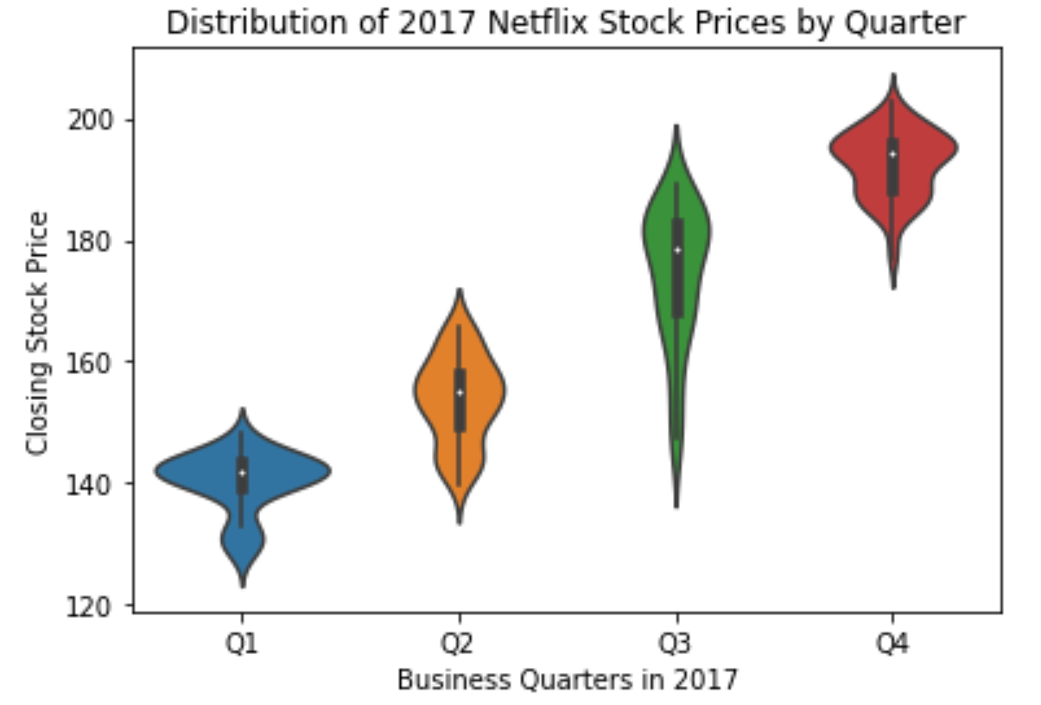
2017 Stock Prices
On average, during 2017, Netflix closing stock prices rose nearly 40%.
Q1 had the lowest closing stock price ($140) and Q4 had the highest closing stock price (~$200).
The range in closing stock price in each quarter was nearly $40.
During 2017, the lowest and highest closing stock prices were $122 and $220.
Fig. 1: Violin distribution plot of 2017 Netflix closing stock prices by quarter.

Slide 4
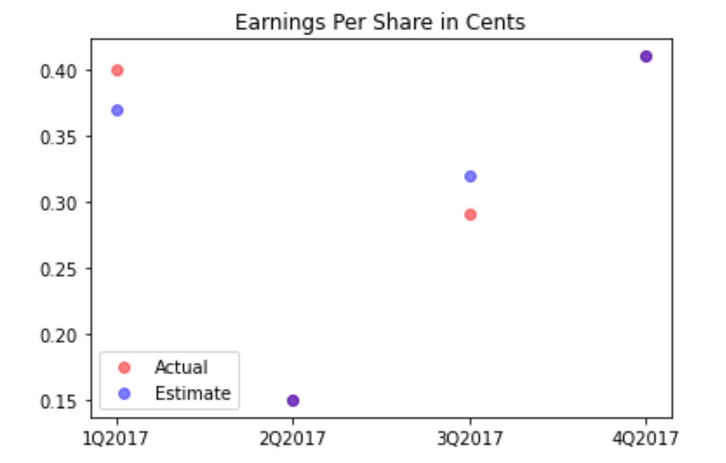
Earnings Per Share
Purple dots indicate points where actual and estimate values for earnings per share in cents were the same for that quarter.
Q2 and Q4 both had the projected estimate for earnings per share be equal to the actual earnings per share value.
Q1 and Q3 the projected estimate was off from the actual earnings per share value.
Fig. 2: Scatter plot of actual vs. estimate 2017 Netflix earnings per share in cents for each quarter.

Slide 5
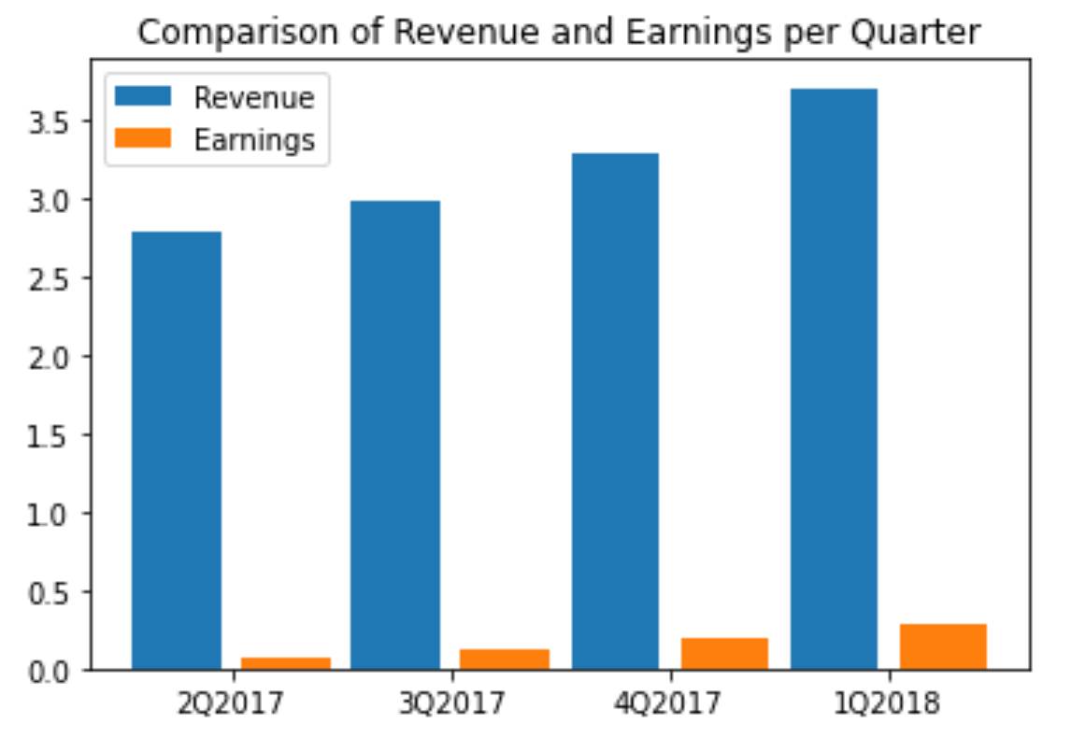
Earnings Per Share
In 2017, revenue increases positively in the 12 month period
In 2017, earnings increases positively in the 12 month period
Fig. 3: Bar plot of revenue and earnings per quarter.

Slide 6
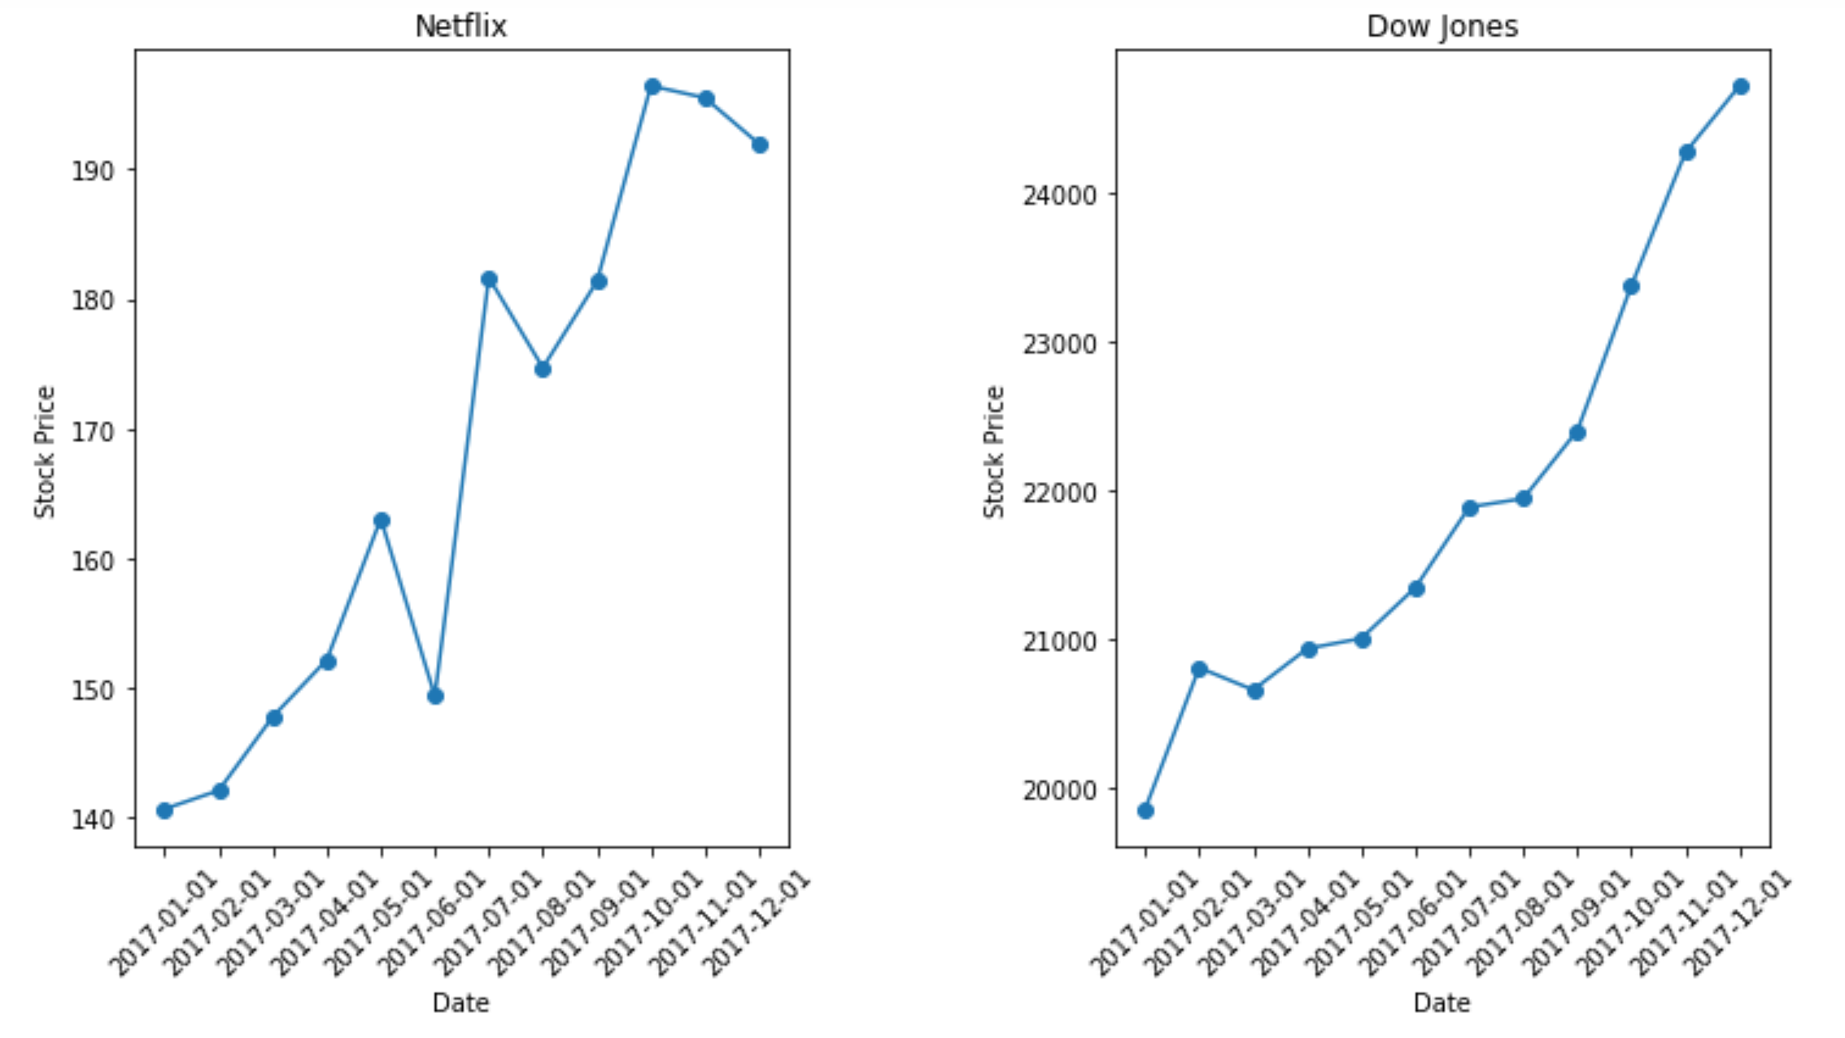
2017 Stock Trend
Netflix's general trend increases overtime which is the same as Dow Jones.
Netflix's stock over 2017 was more volatile since there were major valleys and peaks throughout the 12 months.
Netflix's stock price increases by $50 over 2017 and Dow Jones' stock price increases by $5000 over 12 months.
Fig. 4: (Left) Netflix and (right) Dow Jones plots of stock prices vs. date.

